Slide 1
Lab 2

Slide 2
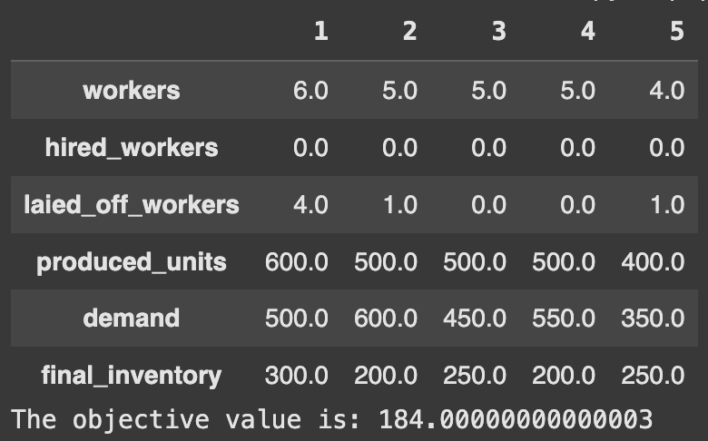
Optimal production plan
Total cost : 184

Slide 3
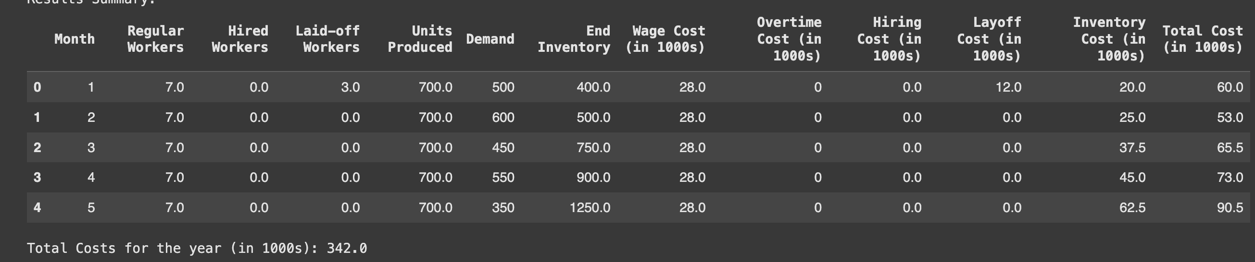
Comparaison with level Strategy

Slide 4
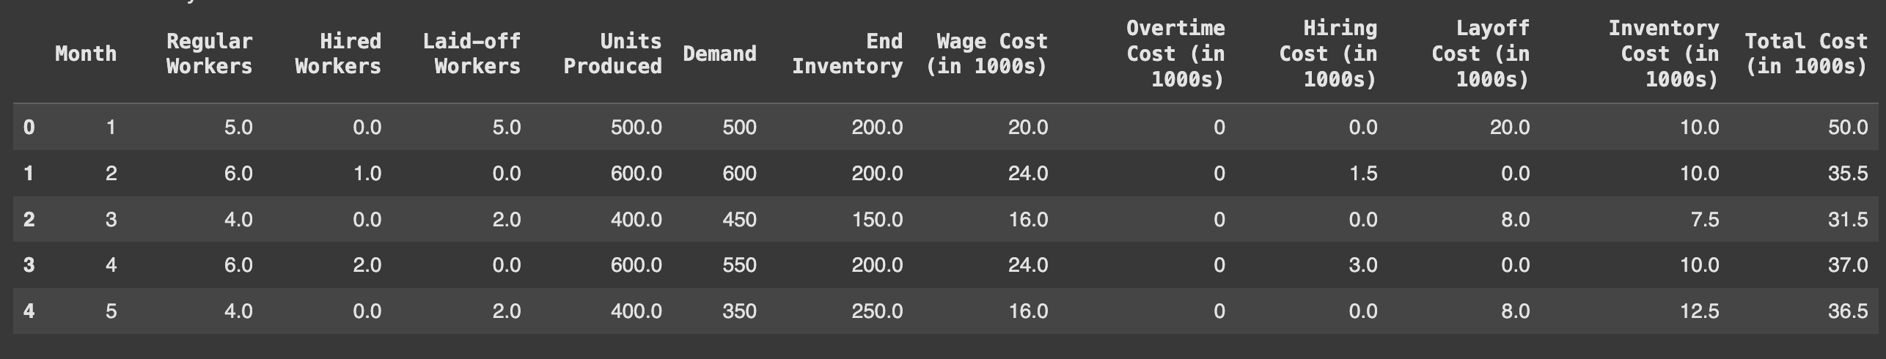
Comparison with Chase strategy
Total :cost 190.5

Slide 5
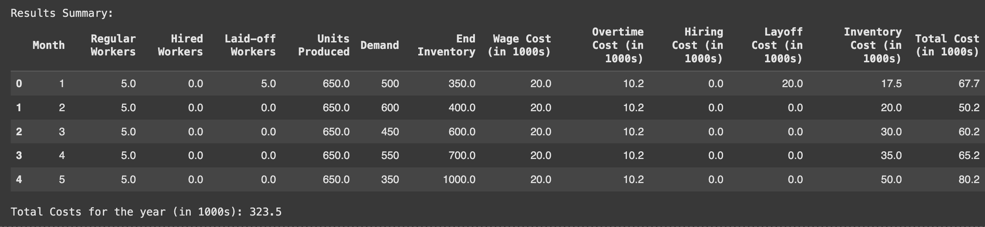
Overtime: Mixed strategy
Hypotheses:
- 30% overtime, it is the % that minimize the cost in this strategy
- overtime is allowed every month

Slide 6
Colab Notebook
https://colab.research.google.com/drive/1bqx0LOMFbmzBY7VrrUKZlUeBytB4wjXj?usp=sharing
I would be very grateful if you could take a look at the notebook and give me notes.

